Slide 1

Topic 6: Data Transformation with dplyr – Part 2

Slide 2
Course Overview
Topic | Description
Session 1
1 | Introduction to R and R Studio Cloud
2 | Exploratory Data Analysis: the tibble and ggplot2
3 | Functions, Vectors and Lists
4 | Introduction to Functionals with purrr
5 | Data Transformation I with dplyr
Session 2
6 | Data Transformation II with dplyr
7 | Statistical Transformation with ggplot2
8 | Advanced Functionals and Modelling with purrr
9 | Exploratory Data Analysis - Case Study using aimsir17

Slide 3
Lecture Overview
Relational data in dplyr
Mutating joins
Filtering joins
tidyr overview
pivot_longer()
pivot_wider()
separate()

Slide 4
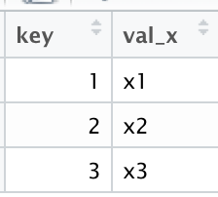
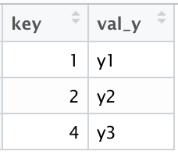
(1) Relational Data with dplyr
Typically, data analysis involves many tables of data that must be combined to answer questions
Collectively, multiple tables of data are called relational data
Relations are always defined between a pair of tables

Slide 5
Keys
The variables used to connect each pair of tables are called keys
A key is a variable (or set of variables) that uniquely identifies an observation
There are two types of keys:
A primary key uniquely identifies an observation in its own table
A foreign key uniquely identifies an observation in another table.

Slide 6
(2) Mutating Joins
Allows you to combine variables from two tables
First matches observations by their keys, and then copies across variables from one table to another
Similar to mutate(), the join functions add variables to the right

Slide 7
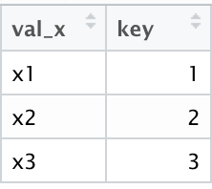
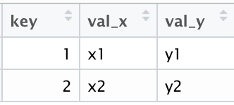
Join Types
Inner Join:
matches pairs of observations when their keys are equal
Unmatched rows are not included in the result
inner_join(x,y,by="key")

Slide 8
Outer Joins
An outer join keeps observations that appear in at least one of the tables. There are three types of outer joins (x,y)
A left join keeps all observations in x
A right join keeps all observations in y
A full join keeps all observations in x and y

Slide 9
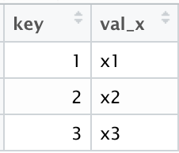
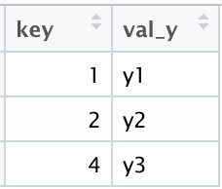
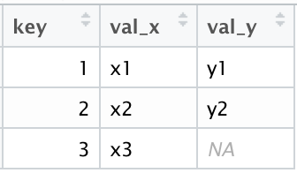
Left Join
left_join(x,y,by="key")

Slide 10
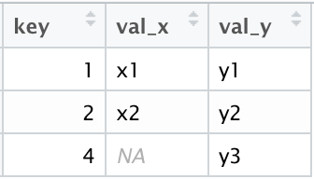
Right Join
right_join(x,y,by="key")

Slide 11
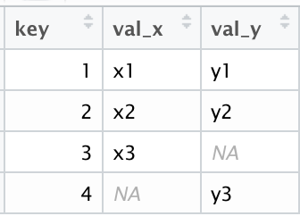
Full Join
full_join(x,y,by="key")

Slide 12
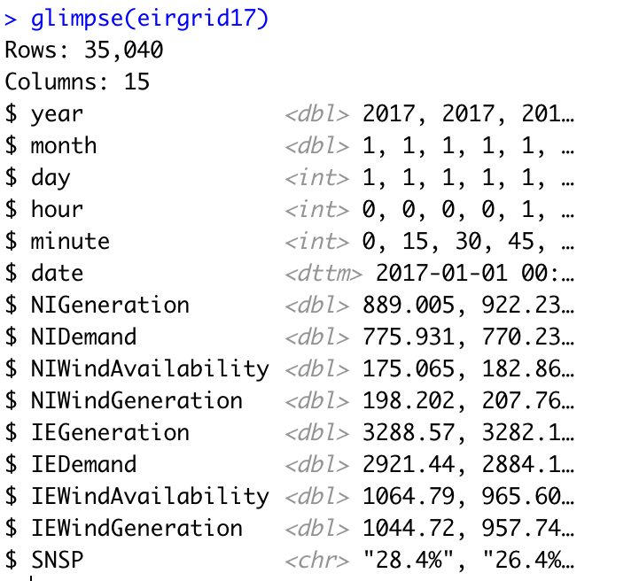
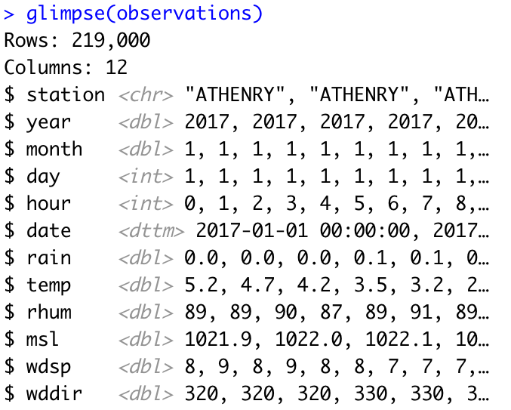
Aimsir17 – common keys

Slide 13
Challenge 6.1 – left_join
For October 2017, filter all observations for mace head
Create hourly observations (mean) of wind energy generated
Join the data sets
Plot the wind speed v wind energy generated, and add a model (also use jitter to show more points)

Slide 14
(3) Filtering Joins
Match observations in the same way as mutating joins, but affect the observations, not the variables
Two types:
semi_join(x,y) keeps all observations in x that have a match in y
anti_join(x,y), drops all observations in x that have a match in y.

Slide 15
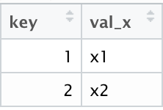
Semi Join
semi_join(x,y,by="key")
keeps all observations in x that have a match in y

Slide 16
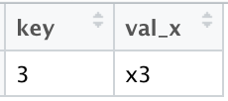
Anti Join
anti_join(x,y,by="key")
drops all observations in x that have a match in y

Slide 17
Challenge 6.2
Explore the relationship between minimum daily temperature and maximum daily electricity demand
Use three weather stations as examples: BELMULLET, DUBLIN AIPRORT and VALENTIA OBSERVATORY.

Slide 18
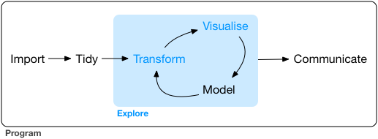
(4) Tidy Data - Overview
What is data tidying?
Structuring datasets to facilitate analysis
The tidy data standard is designed to:
Facilitate initial exploration and analysis of data
Simplify the development of data analysis tools that work well together
Principles closely related to relational algebra (Codd 1990)
Related packages: tidyr, ggplot2, dplyr

Slide 19
Why tidy data? (Wickham et al. p150)
Advantage to picking one consistent way of storing data. Easier to learn tools that work with tidy data because they have a underlying uniformity
Specific advantage to placing variables in columns because it allows R’s vectorised functions to shine.
dplyr, ggplot2 designed to work with tidy data

Slide 20
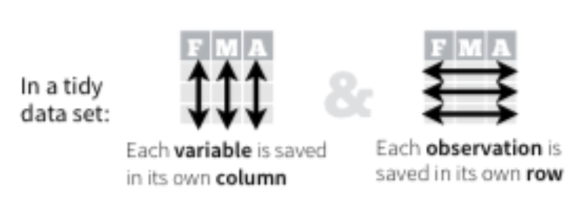
Rules for a Tidy Dataset
Each variable must have its own column
Each observation must have its own row
Each value must have its own cell
Put every dataset in a tibble
Put each variable in a column
https://rpubs.com/bradleyboehmke/data_wrangling

Slide 21
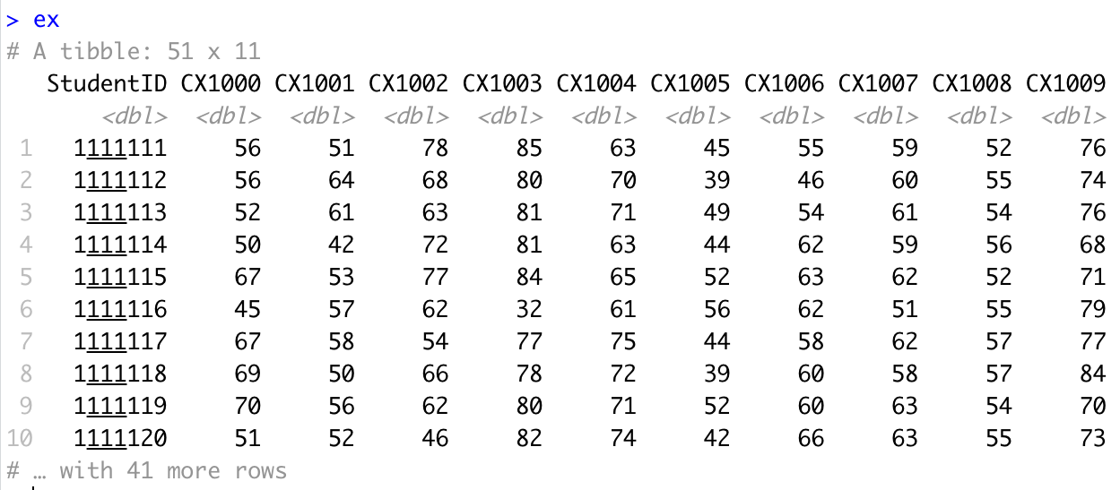
Example in R – untidy data

Slide 22
Identify the variables
Variables
Student
Subject
Result
https://rpubs.com/bradleyboehmke/data_wrangling

Slide 23
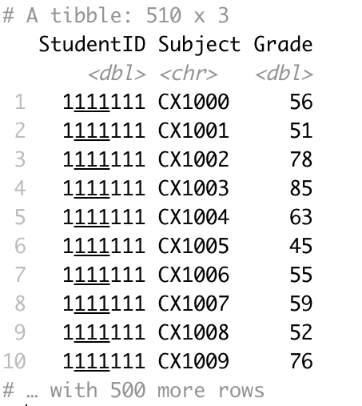
The goal…

Slide 24
tidyr package – sample functions of data tidying
pivot_longer() takes multiple columns, and gathers them into key-value pairs: it makes “wide” data longer
pivot_wider() takes two columns (key and value) and spreads into multiple columns, it makes long data wider
separate() splits a single column into multiple columns

Slide 25
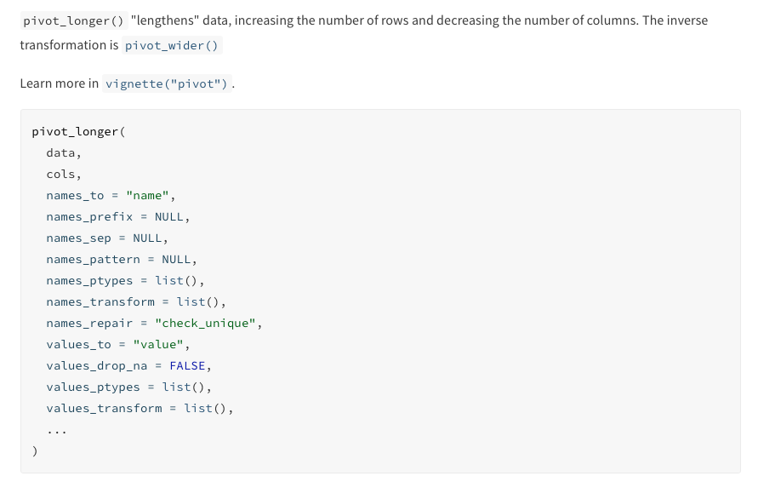
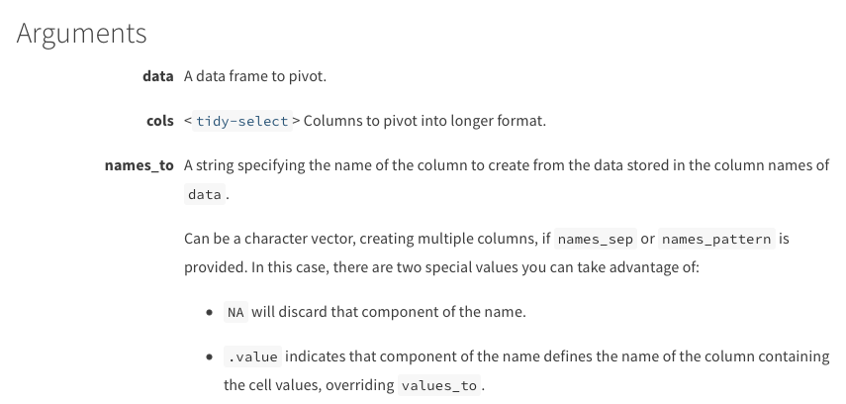
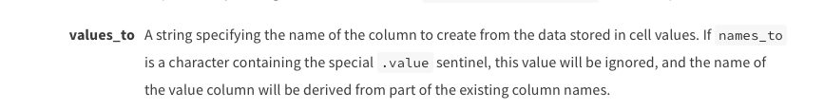
pivot_longer()

Slide 26
For example…

Slide 27
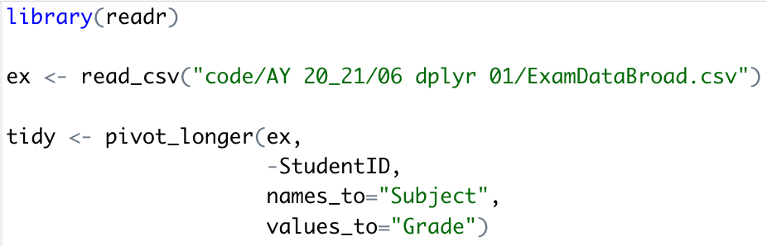
pivot_longer() Function call

Slide 28
Tidy data Supports data exploration

Slide 30
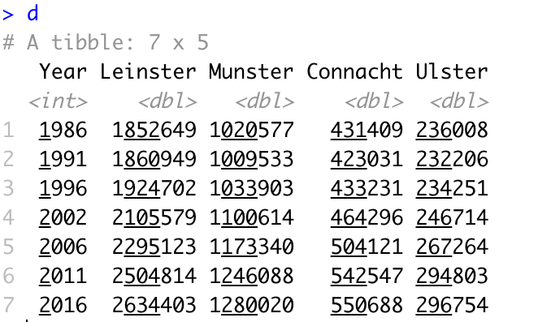
Challenge 6.3
Transform the census data to tidy format and create the following plot

Slide 31
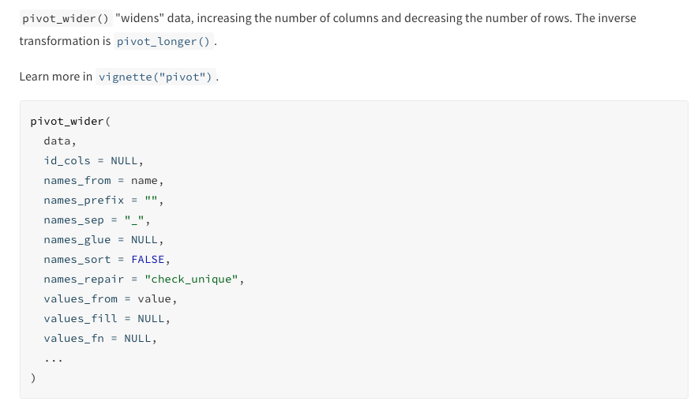
pivot_wider()
https://tidyr.tidyverse.org/reference/pivot_wider.html

Slide 32
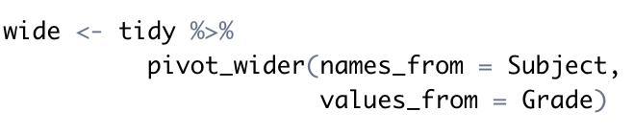
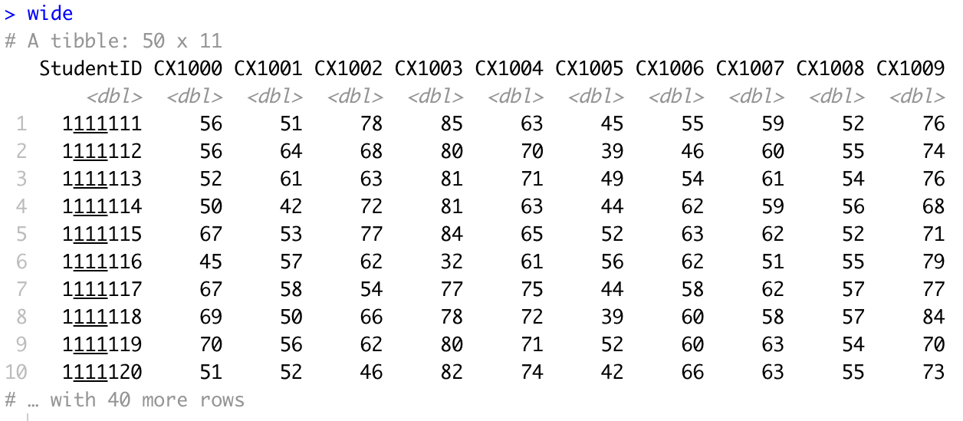

Slide 33
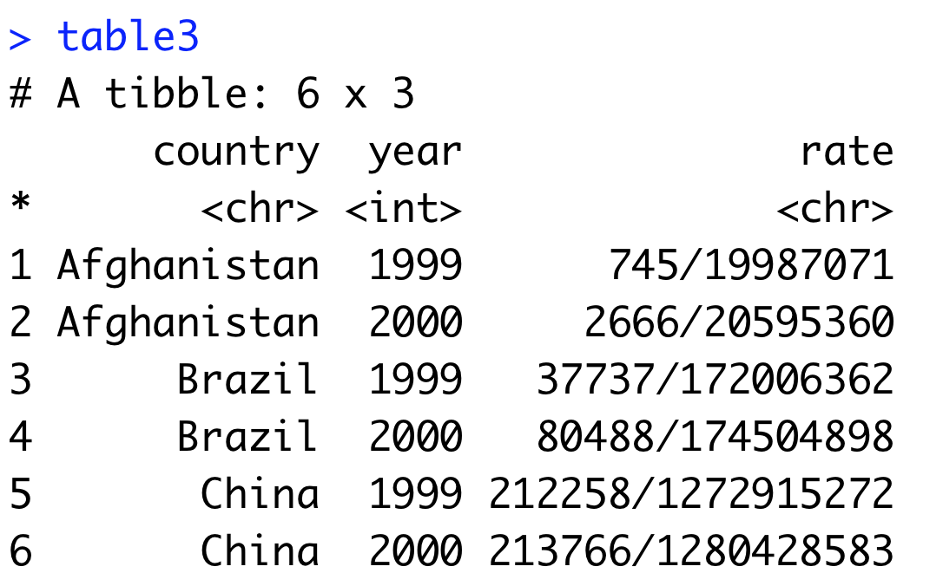
separate()
Separate pulls apart one column into multiple columns
It splits the information based on finding a non-alphanumeric character
Separator can be defined (sep=“/”)
A converter can find best type for the result, if needed.

Slide 34
